Slide 1
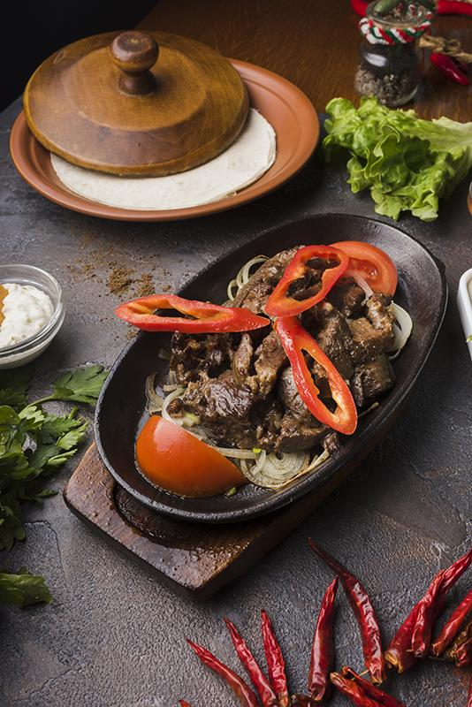
Restaurant Customer Rating

Slide 2
Introduction
Here’s an interesting tidbit about restaurants:
- Millennials allocate 44% of their food budget to dining out (source).
A rising number of restaurants are adopting cashless payment systems, though this practice is illegal in certain states, such as Massachusetts.
Project Goal:
The goal of this project is to analyze the key factors that contribute to the popularity of the most visited restaurants, such as service quality, cuisine type, and location. The dataset includes information on restaurants, user profiles, and user ratings for various dining establishments.

Slide 3

Objectives of the Project
01
02
03
4
To find out how the customer satisfaction based on various service rating and food rating
To find out the most popular restaurant based on the visits
To find out the most popular cuisine

Slide 4
DATA CLEANING

Slide 5
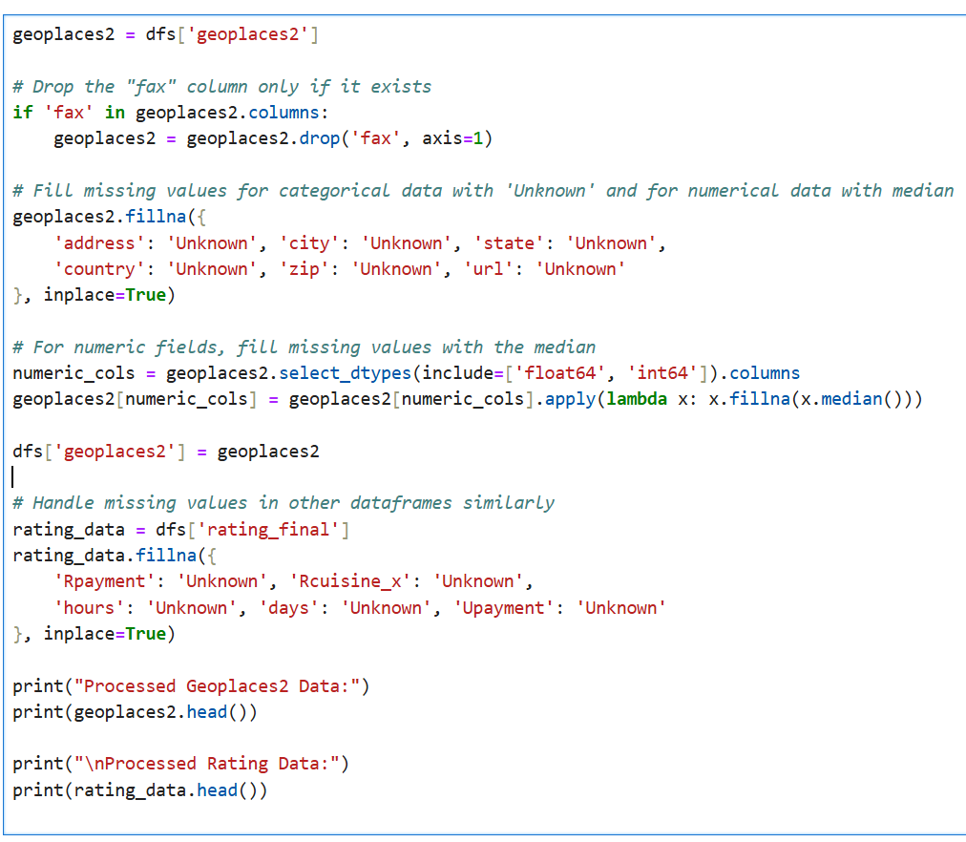

Missing Values
Handling Missing Values:
1. Checked for missing values in the files.
2. Dropped columns that had missing data in all cells.
3. Filled columns with incomplete data using the median.
4. Replaced missing categorical values with "unknown."

Slide 6
EXPLORATORY DATA ANALYSIS

Slide 7
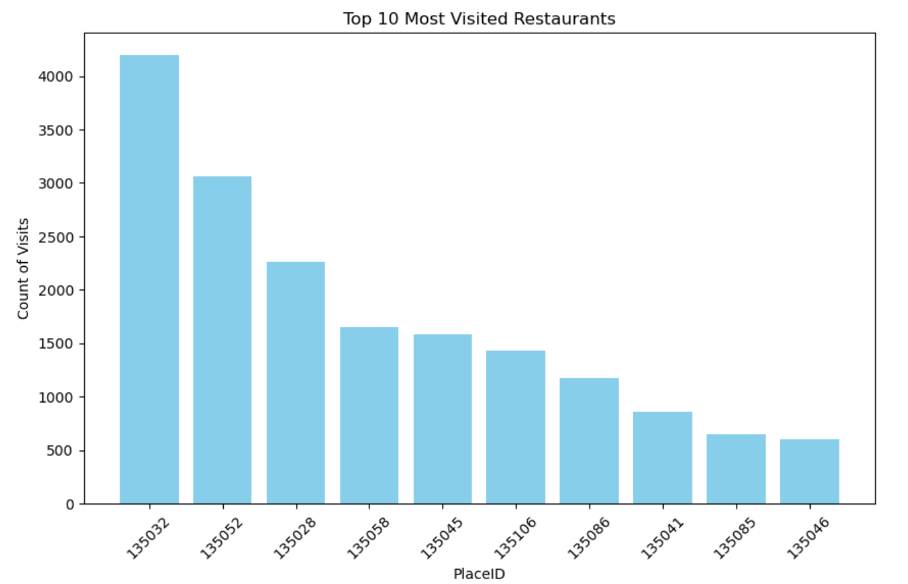
Exploratory Data Analysis (EDA)
The EDA revealed important patterns and relationships within the data.
Most Visited Restaurant: The graph plotted shows the the top 10 most visited restaurants.

Slide 8
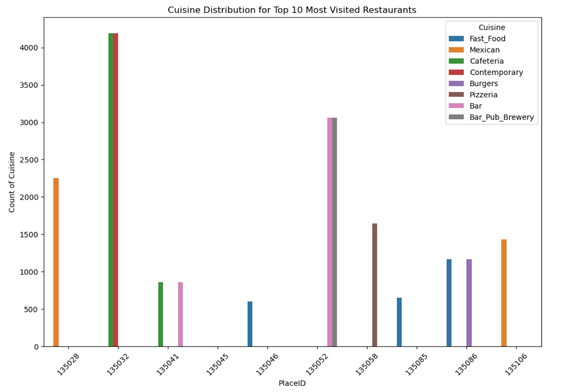
Exploratory Data Analysis (EDA)
Impact of Cuisines: From the most visited restaurants, the graph shows certain cuisines received higher ratings on average, indicating customer preferences for specific types of food.

Slide 9
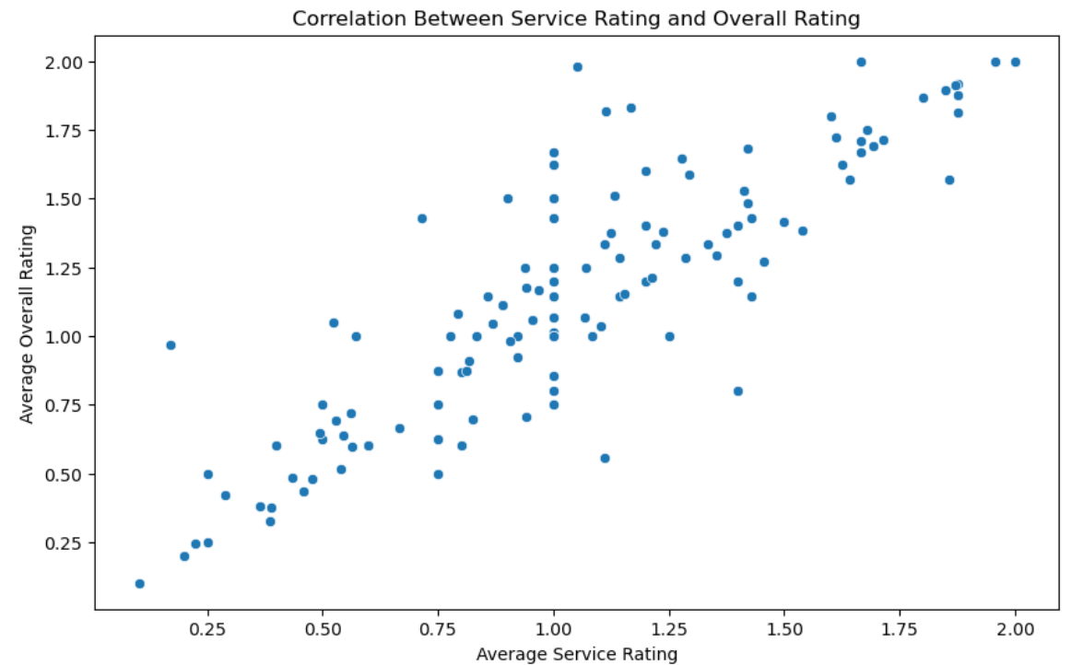
Exploratory Data Analysis (EDA)
Service Metrics: From the highly ranked cuisines above from the top 10 visited restaurants, there appears to be a correlation between service metrics (e.g. service rating) and overall customer satisfaction.

Slide 10
PREDICTIVE MODEL

Slide 11
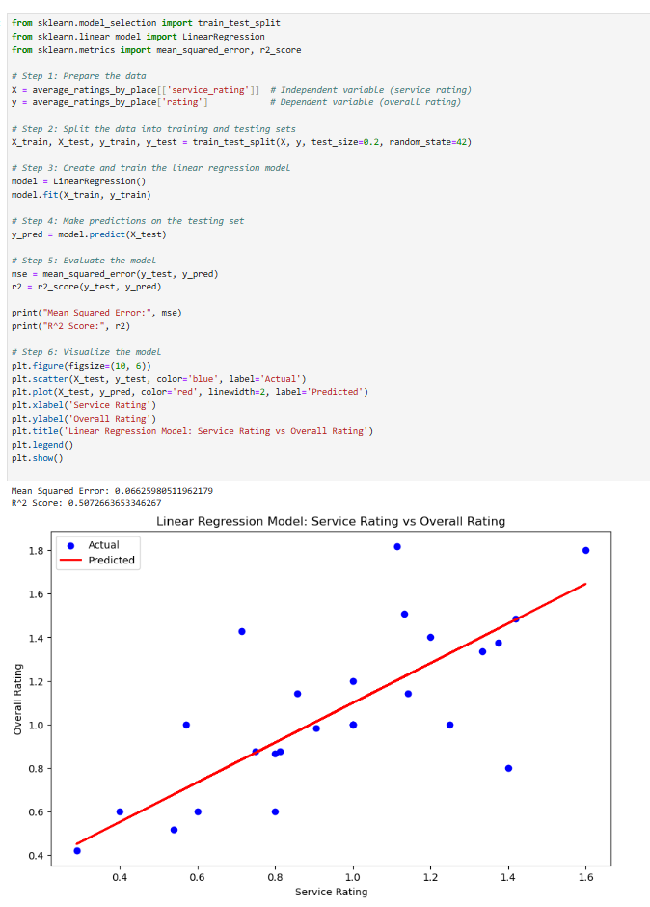
Linear Regression Model
Developed a Linear Regression model to predict customer satisfaction based on service metrics.
The model showed a reasonable performance, with an MSE of 0.06 and an R-squared value of 0.5, indicating that the selected features were effective predictors of customer satisfaction.
Feature importance analysis revealed that service rating and the overall rating were the most significant factors influencing customer ratings.

Slide 12
CONCLUSION

Slide 13
Key Findings
There are a lot of customers going to various restaurants, whereby the top 10 most visited restaurants are located in Mexico.
Based on cuisine type the highest ranked is Fast_Food derived from the food ratings by customers.
From the model evaluation, a Linear Regression model was used to predict overall ratings based on service ratings. There appears to be a positive correlation between service rating and overall rating.

Slide 14
Recommendations
Restaurants should focus on improving key service metrics, particularly hours of operation, to enhance customer satisfaction.
Understanding customer preferences for specific cuisines can help restaurants tailor their offerings to better meet customer expectations.
Regular analysis of user feedback and ratings can provide ongoing insights into areas of improvement and strengths.

